Slide 1
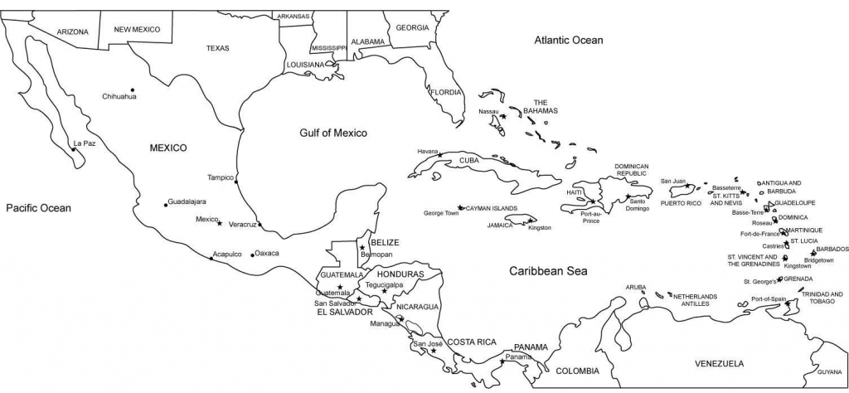
Renata Clarke
Sub-Regional Coordinator for the Caribbean
FAO
Exploring the production of insects as a feed source in the Caribbean Region

Slide 2
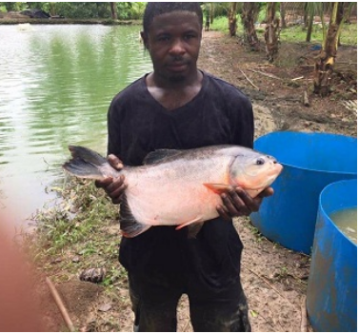
Why an interest in insects as a feed source in the Caribbean?
Unsustainable regional food import expenditure ($3,808,756 US (2019)
Animal feed imports: $88,000,000USD (2019) for livestock
$35,000,000USD in pet food for retail sales
CARICOM Heads of Gov call to decrease food import bill by 25% by 2025
Diversification of economy and creation of jobs – critical for resilience
Inclusive models of development are required
Recognized need to safeguard the stability of food supplies
Reducing environmental footprint is core
© Kent Farms, Trinidad and Tobago
There is a need to transform food systems in the Caribbean - NOW

Slide 3
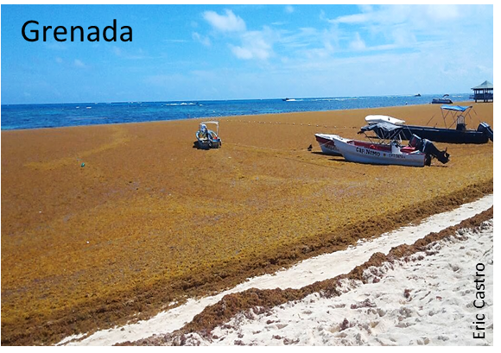
We need to leapfrog…
The economics needs to make sense
Bio-security?
Locally available and cheap substrate for insects?
Food safety?
Initial investment cost? Running costs?
Other legislative requirements?
Suitability for “small-scale” investors…?
Eric Castro
We have the tertiary and research capacities to support the adaptation of available technologies

Slide 4
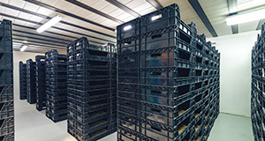
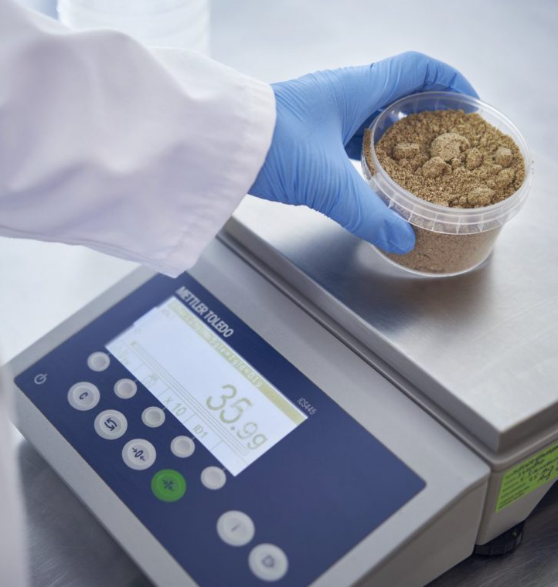
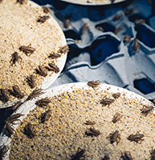
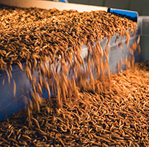
We are ready to work on this … who wants to collaborate?
© Protifarm, Agronutris/Micronutris

